Slide 1

MSc Thesis:
Bending-Twist Shape Adaptation of Wings by Compliant Chiral Spar Design
Alejandro Valverde López
Supervisor: Dr. Simon Prince
04.09.2017

Slide 2
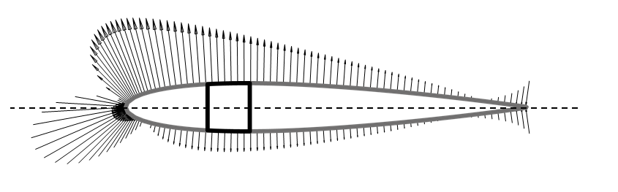

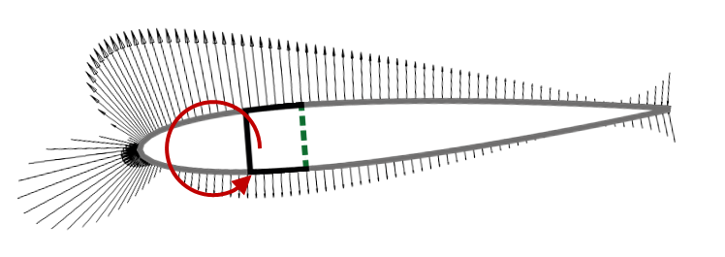
Motivation
Alejandro Valverde
alejandro.valverde@cranfield.ac.uk
Gust allevation
Wing demonstrator
Fig 2: Wing demonstrator, Raither (2013)
Fig 1: Gust alleviation mechanism
Notes:
The concept presented in this work proposes a new technology of wing twist morphing
Such a wing capacity may become suitable for applications such as gust alleviation, in which a quick change of the lift distribution is needed

Slide 3
Presentation outline
Alejandro Valverde
alejandro.valverde@cranfield.ac.uk
Working principle
Analytical and computational model descriptions
Preliminary analysis
Results from simulations
Conclusions and outlook

Slide 4
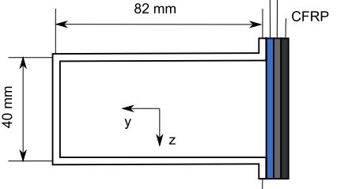
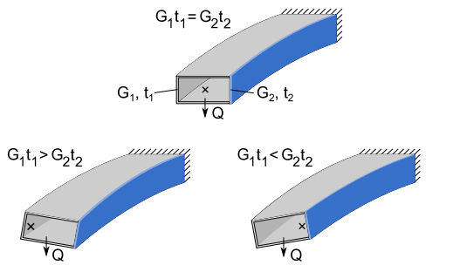
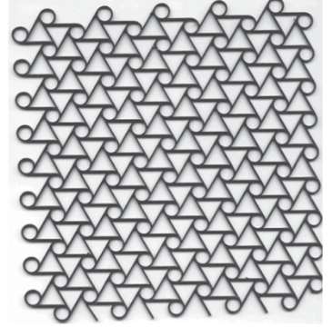
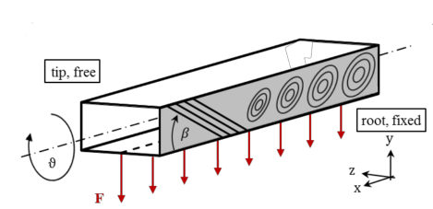
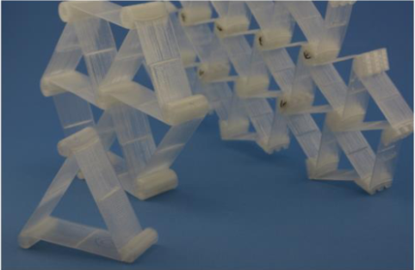
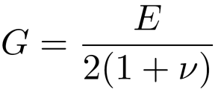
Different approaches
Alejandro Valverde
alejandro.valverde@cranfield.ac.uk
Working principle, publicated on: Raither(2013)
ΔT → G₂ t₂
Aluminium
Elastomer
PVC
Fig 4: Variable elastic modulus of the polymer web due to temperature changes, Raither (2012)
Fig 3: Working principle, Raither (2013)
Current project: Buckling-induced shear modulus variation
Runkel (2015): Δβ → material anisotropy
Fig 6: Chiral structures in lattice
Fig 5: Plate buckling field at the root in the adaptive spar, Runkel (2015)
Notes:
Working principle
- The variable shear stiffness G2t2 that is required for the activation of the adaptive web can in principle be achieved by changing either the web’s shear modulus or its thickness.
- The change in shear stiffness of the adaptive web leads to a shift of the shear center position and thus to a non-zero twist of the profile.
Different methods have been already presented to achieve a variable stiffness web.
Case 1-Raither: - ACTIVE
An implementation based on the variation of the elastic modulus of a polymer web due to changes in temperature is investigated.
Case 2-Runkel: - PASSIVE
A particular material anisotropy by varying fibre orientation and thickness of the component is introduced.
Case 3-Chiral:
At a particular external load, the shear flow in the web exceeds the buckling limit, resulting in a drastic reduction of the effective shear modulus of this structural element

Slide 5
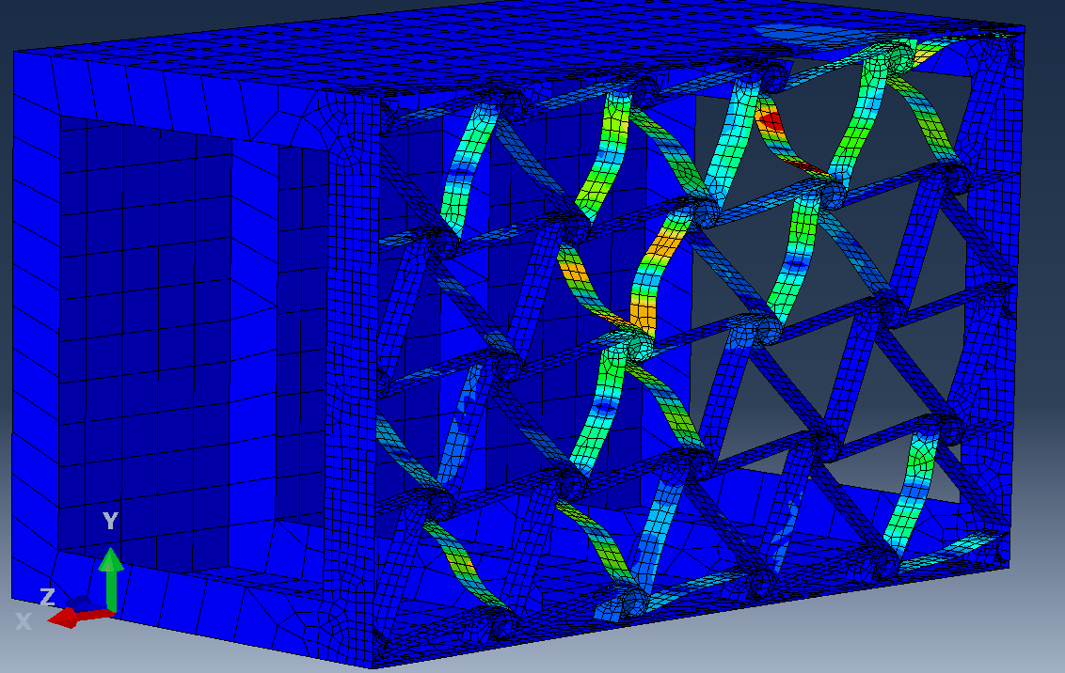
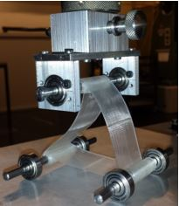
Working principle for the proposed technology
Alejandro Valverde
alejandro.valverde@cranfield.ac.uk
Elastic instabilities induced on the chiral elements ligaments
Reduction of the overall shear modulus G₂ for the lattice of chiral structures
An effective shear modulus G_{2,eff} is introduced, G_{2,eff} <G₁
Fig 7: Induced elastic instabilities in the chiral elements that provoke a wing twist adaptation
Fig 8: Compression load test on a basic triangular chiral structure Ramstein (2016)
Notes:
Why to use the chiral structure?
The term “chiral” refers to its distribution in space, being distinguishable from their mirror image
Negative Poisson ratio, shear modulus
Theoretical infinity shear stiffness, once buckling is activated

Slide 6
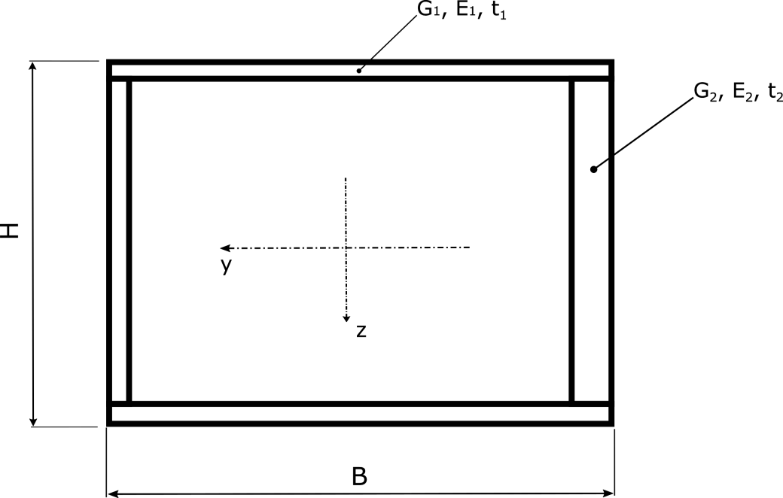
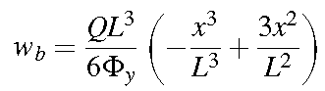
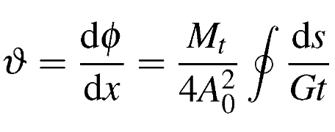
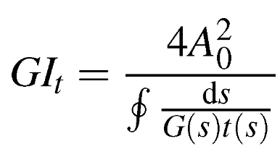
Analytical model
Alejandro Valverde
alejandro.valverde@cranfield.ac.uk
Parametrization and mechanical properties of the beam
Bending deformation provided by Bernoulli-Euler equation:
Specific twist due to torsion provided by St. Venant equation:
Fig 9: Analytical model of the closed section beam
Geometrical parameters:
Cross-sectional aspect ratio: B / H
Thickness ratio: t₁ / t₂
Mechanical properties:
Shear stiffness ratio: G₁ / G₂
Young’s modulus ratio: E₁ / E₂
Torsional stiffness:
Notes:
For the analytical model, the wing-box is modeled like a beam possessing variable stiffness properties in one of the webs.
The following mechanical properties can be obtained using the equations described here…
This two (point to bending and twist) provide information of the flexural and torsional compliances that are evaluated for…. (go to next slide)

Slide 7
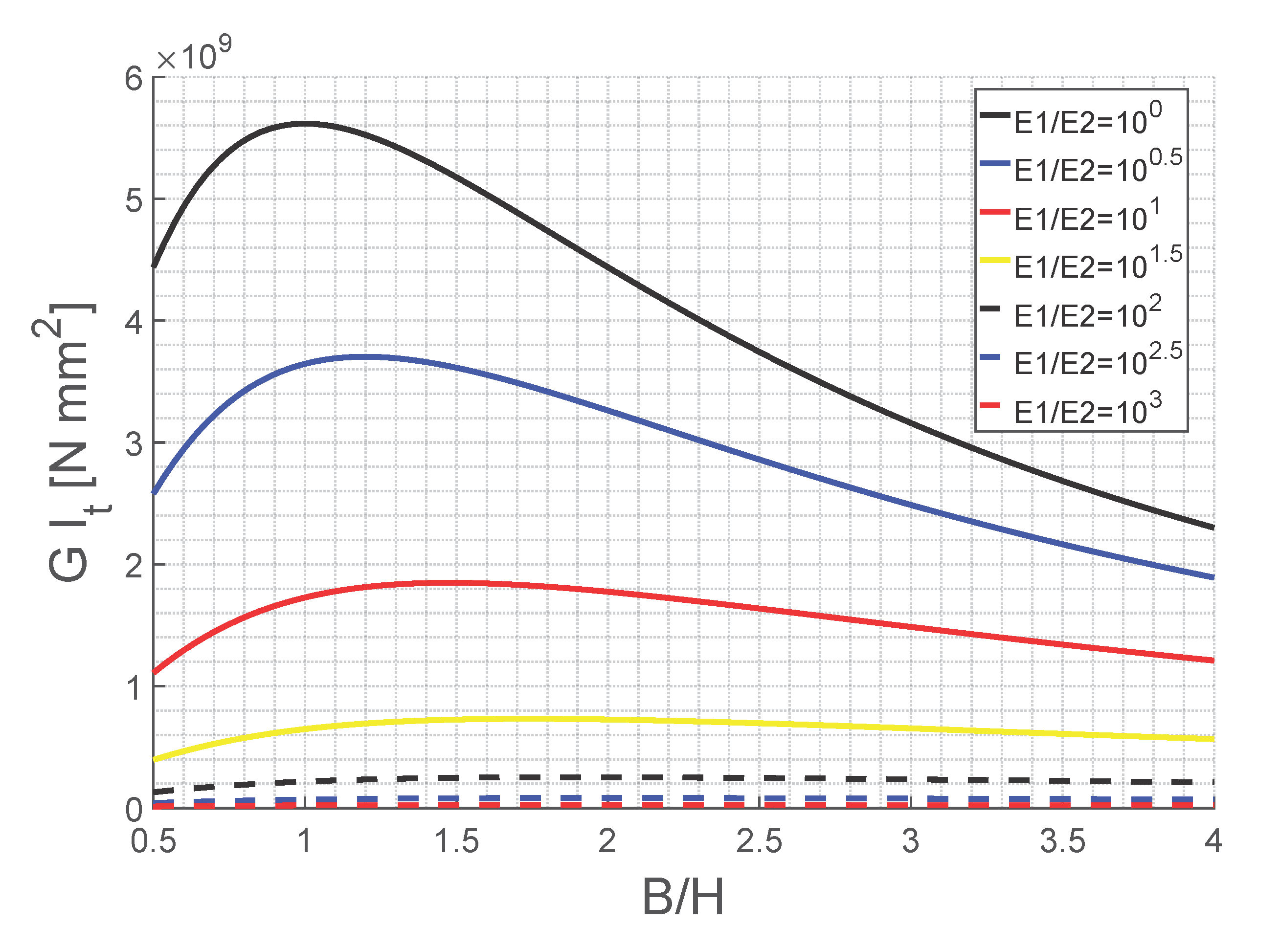
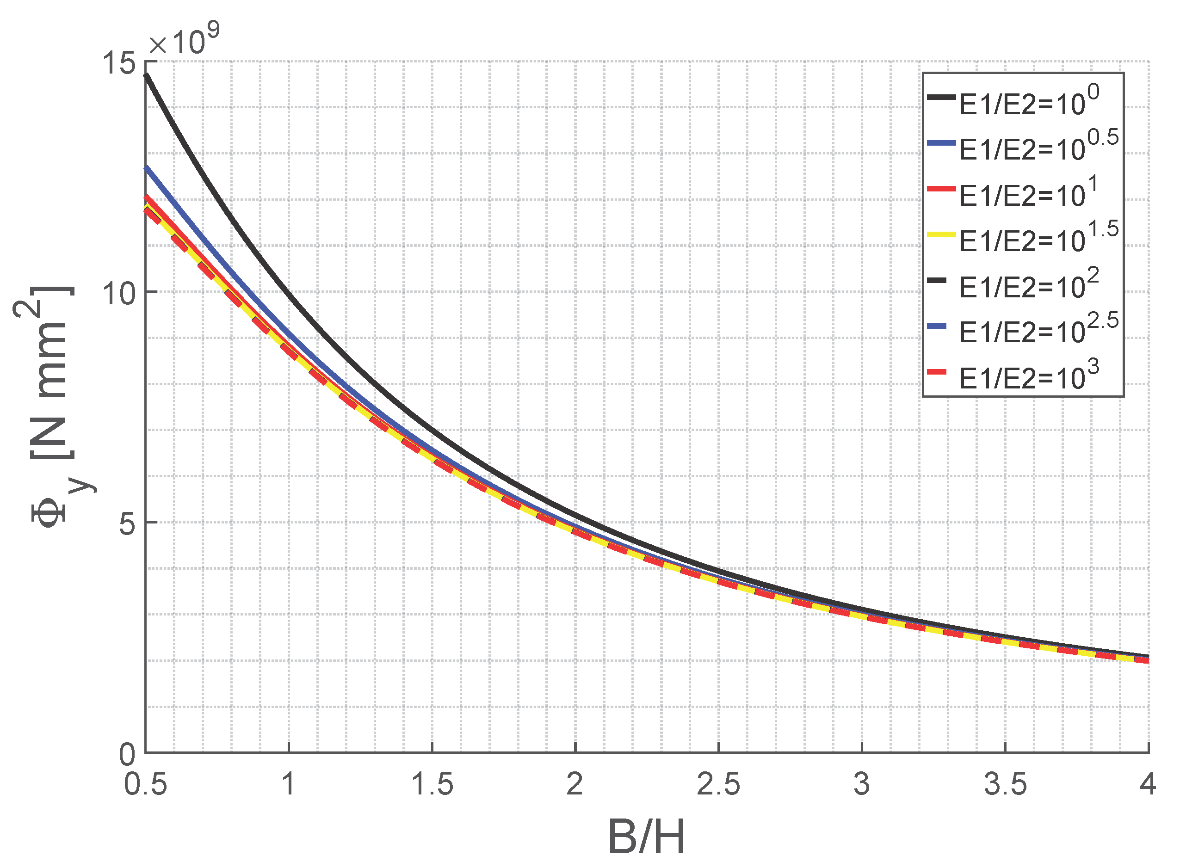
Results from the analytical model
Alejandro Valverde
alejandro.valverde@cranfield.ac.uk
Preliminary results
Fig 10: Influence of the cross-sectional aspect ratio B/H on the torsional stiffness G I_{t} , shown for various values of the stiffness ratio E₁ / E₂
Fig 11: Influence of the cross-sectional aspect ratio B/H on the flexural stiffness Φ_{y}, shown for various values of the stiffness ratio E₁ / E₂

Slide 8
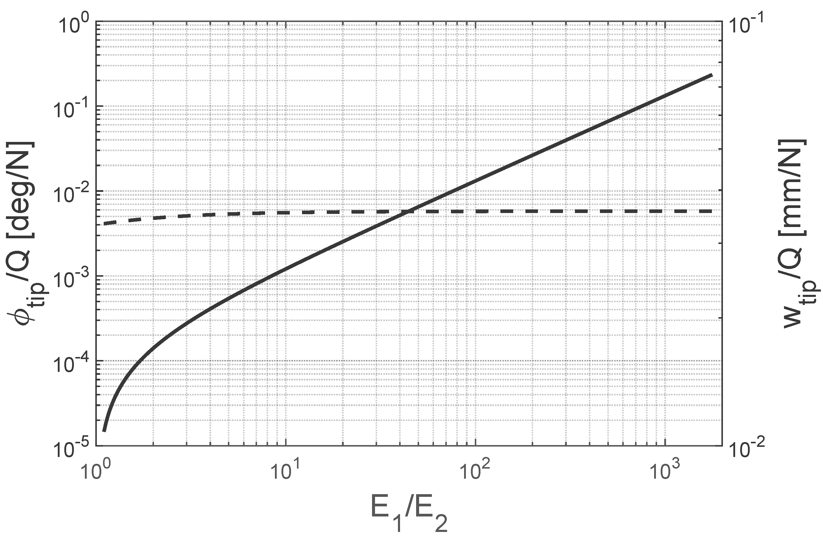
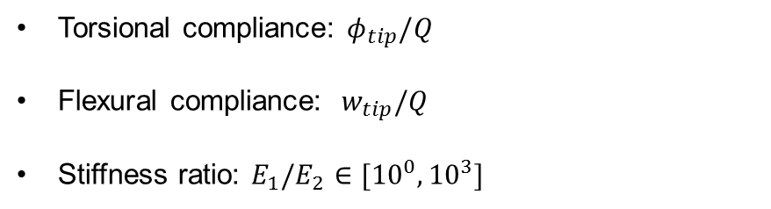
Results from the analytical model
Alejandro Valverde
alejandro.valverde@cranfield.ac.uk
Preliminary results
Torsional compliance: $φ_{tip}/Q$
Flexural compliance: ${ w}_{tip}/Q$
Stiffness ratio: $E_{1}/E_{2}$ $∈[{10}^{0}, {10}^{3}]$
Torsional stiffness much more sensible to variations of the stiffness ratio.
The mechanism activation is not expected to result in large variations of the bending displacement.
Fig 12: Torsional and flexural compliances as a function of the stiffness ratio
Notes:
(from previous slide) … a range of stiffness ratio.
The plot shows how the torsional compliance is much more affected by changes in the stiffness of the adaptive web than the flexural compliance.
After the mechanism activation, it is expected to see a variation in shear stiffness of this magnitude (point graph) and this plot is telling us that the consequent bending adaptation is going to be neglectable in comparison with the twist adaptation.
Now, the computational model is explained… (go to next slide)

Slide 9
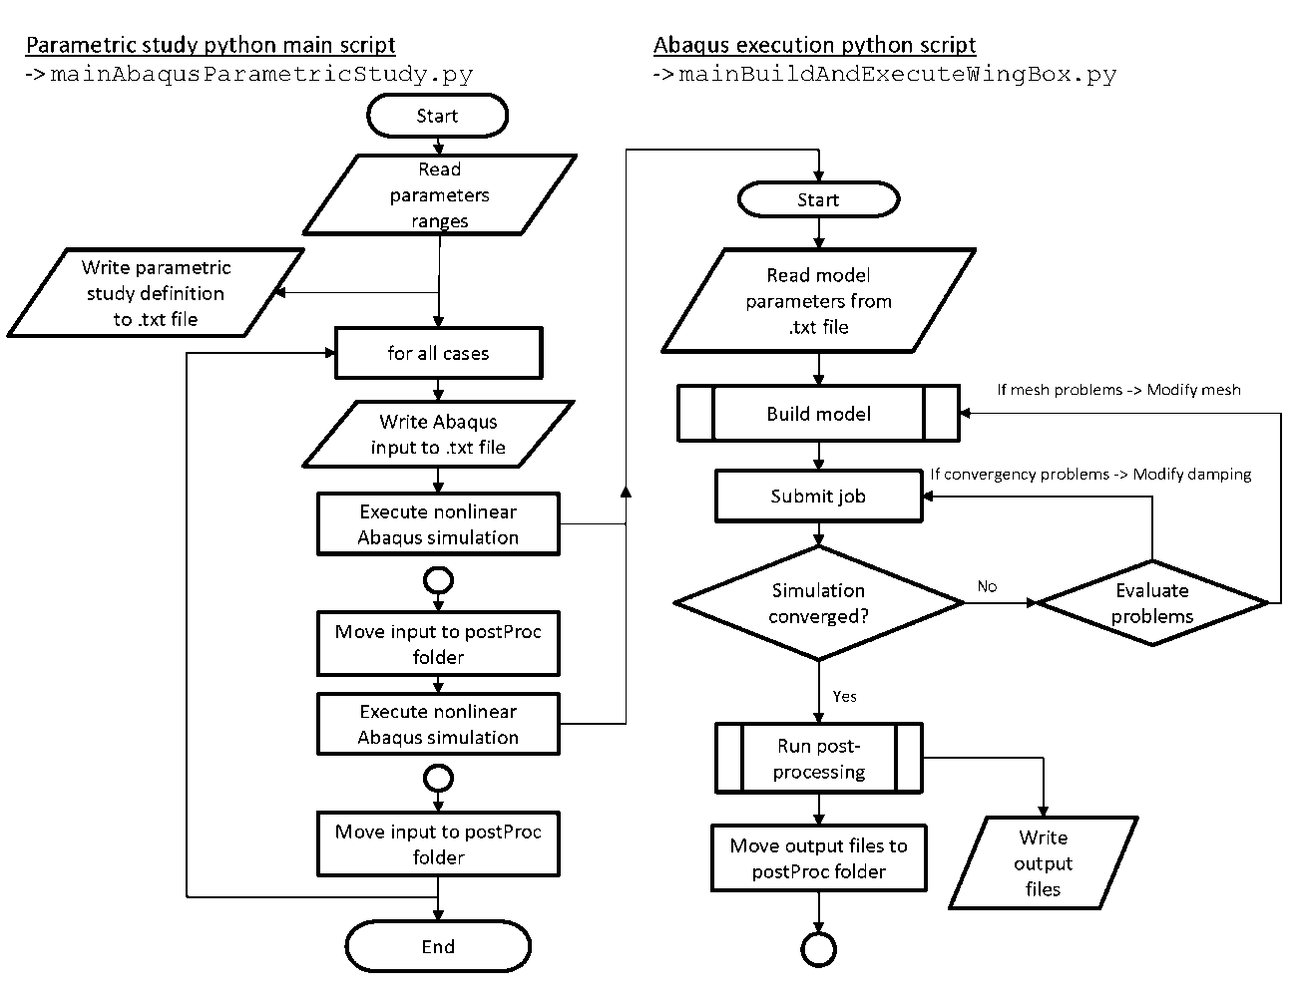
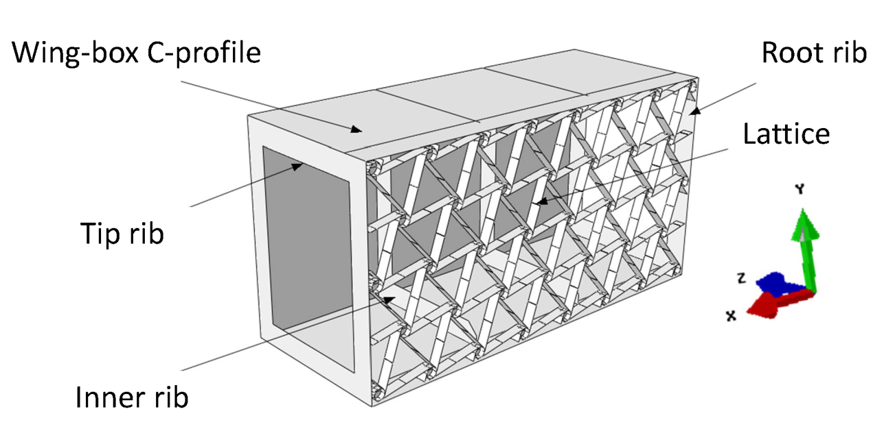
Computational model
Alejandro Valverde
alejandro.valverde@cranfield.ac.uk
Execution of nonlinear simulations on Abaqus CAE
Fig 14: General assembly of the computational model
Fig 13: Flow chart showing the execution of the parametric study python code
Notes:
The computational model is characterized for the following parts…
The model is built using python scripting and a program is written that automatically executes a number of simulations for a range of parameters

Slide 10
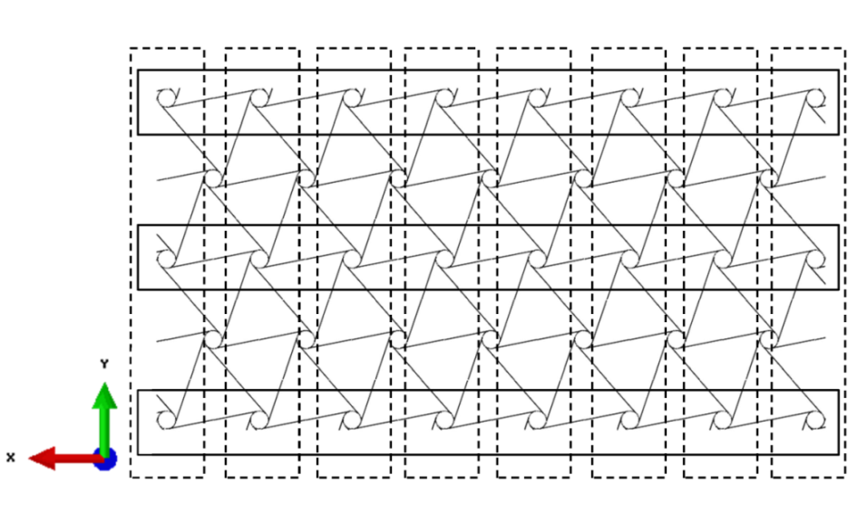
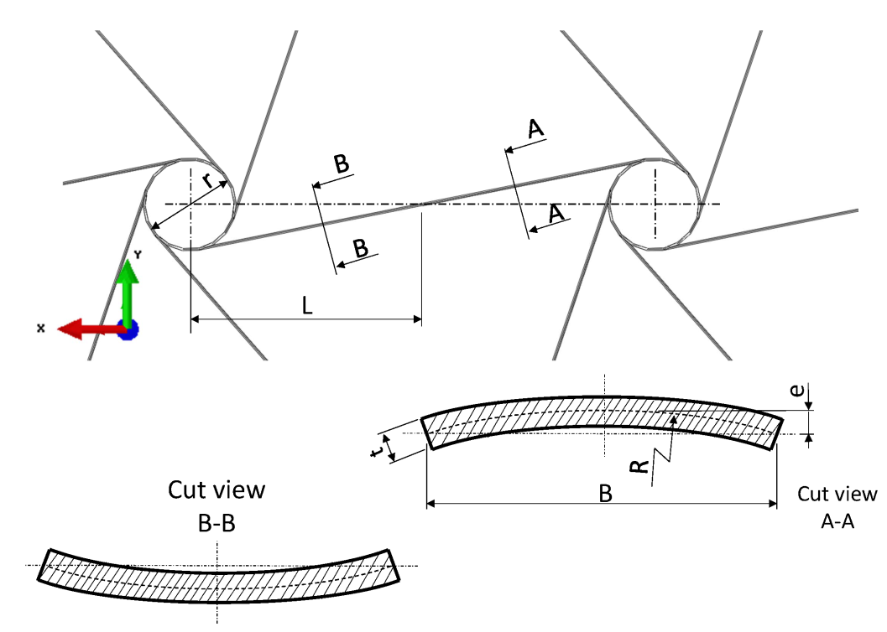
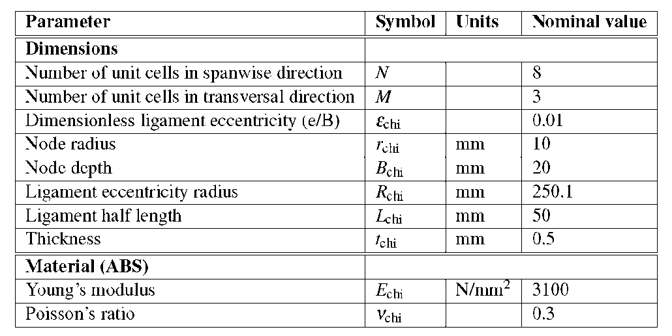
Computational model
Alejandro Valverde
alejandro.valverde@cranfield.ac.uk
Chiral structure description
Fig 16: Division of the chiral structure in N and M unit cells
Fig 15: Internal parameters for the chiral structure design
Fig 17: Parameters used in the chiral structure lattice design
Notes:
The essential part in the design of the wing-box is the compliant spar that incorporates de chiral lattice.
The chiral structure is divide in an “N” number of unit cells in the spanwise direction of the wing-box and a “M” number of unit cells in the transversal direction.
The parameters that conform the geometry in the chiral structure are:
The node depth B
The node radius r
The ligament half length L
The ligament eccentricity e
The overall thickness t

Slide 11
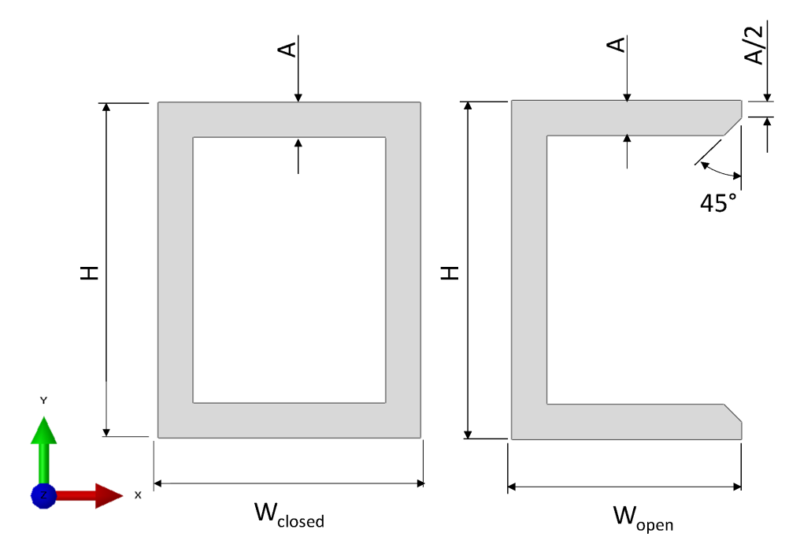
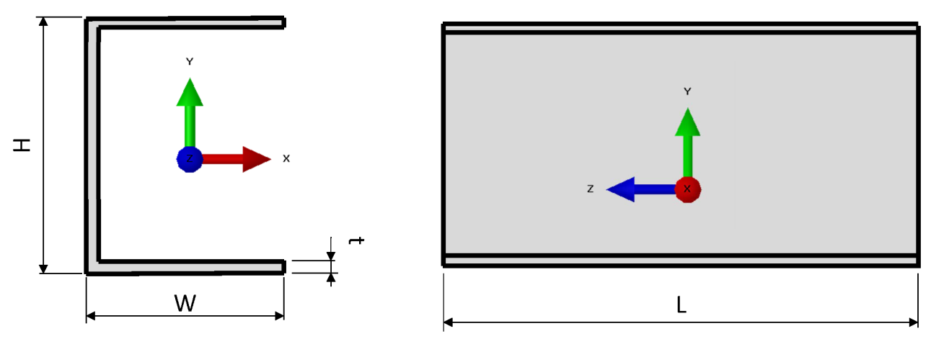
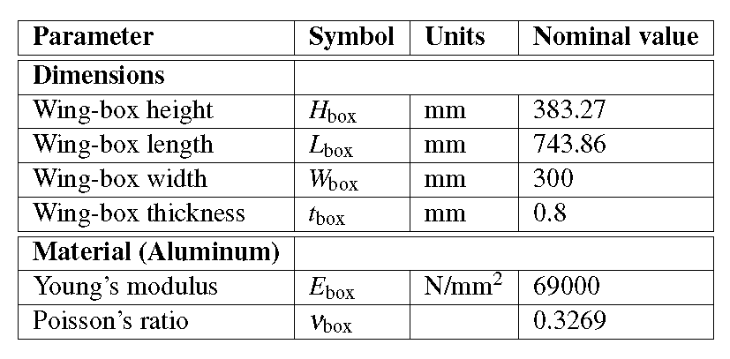
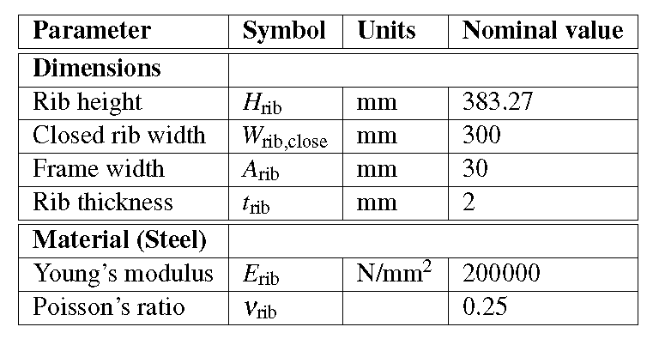
Computational model
Alejandro Valverde
alejandro.valverde@cranfield.ac.uk
Wing-box in C-profile and ribs
Fig 18: Characteristic dimensions of the wing-box design
Fig 20: Characteristic dimensions of ribs design
Fig 19: Parameters used in the chiral structure lattice design
Fig 21: Parameters used in the ribs design

Slide 12

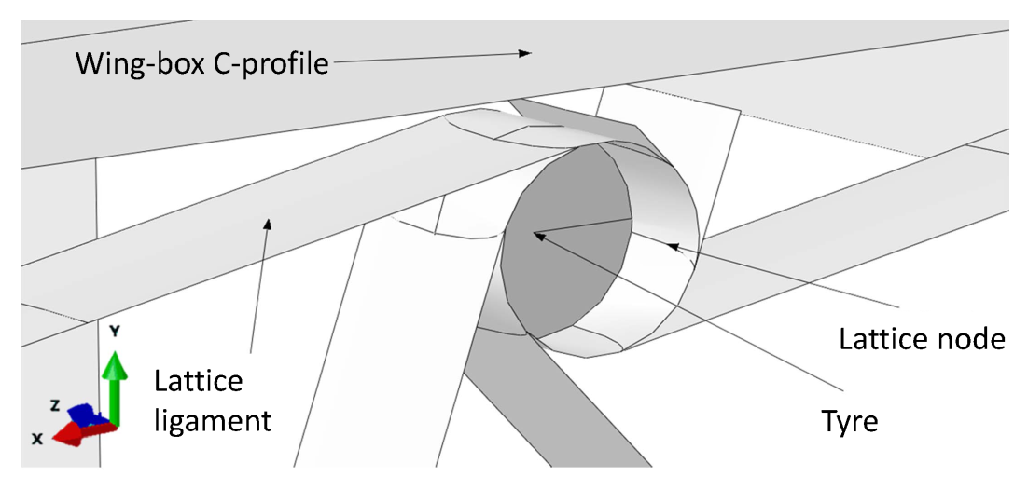
Computational model
Alejandro Valverde
alejandro.valverde@cranfield.ac.uk
Chiral lattice nodes rigid modeling
Fig 22: Tyre embedded into the lattice chiral node
Fig 23: Chiral nodes on the manufactured demonstrator, Vincenz (2016)
Notes:
One of the most relevant aspects of the design is the lattice node rigid body modeling. In this picture of one of the manufactured prototypes, it can be seen two different approached to manufacture the rigid node.
In the computational model, this part is modeled through the addition of an additional rigid part called tyre that adds stiffness.

Slide 13
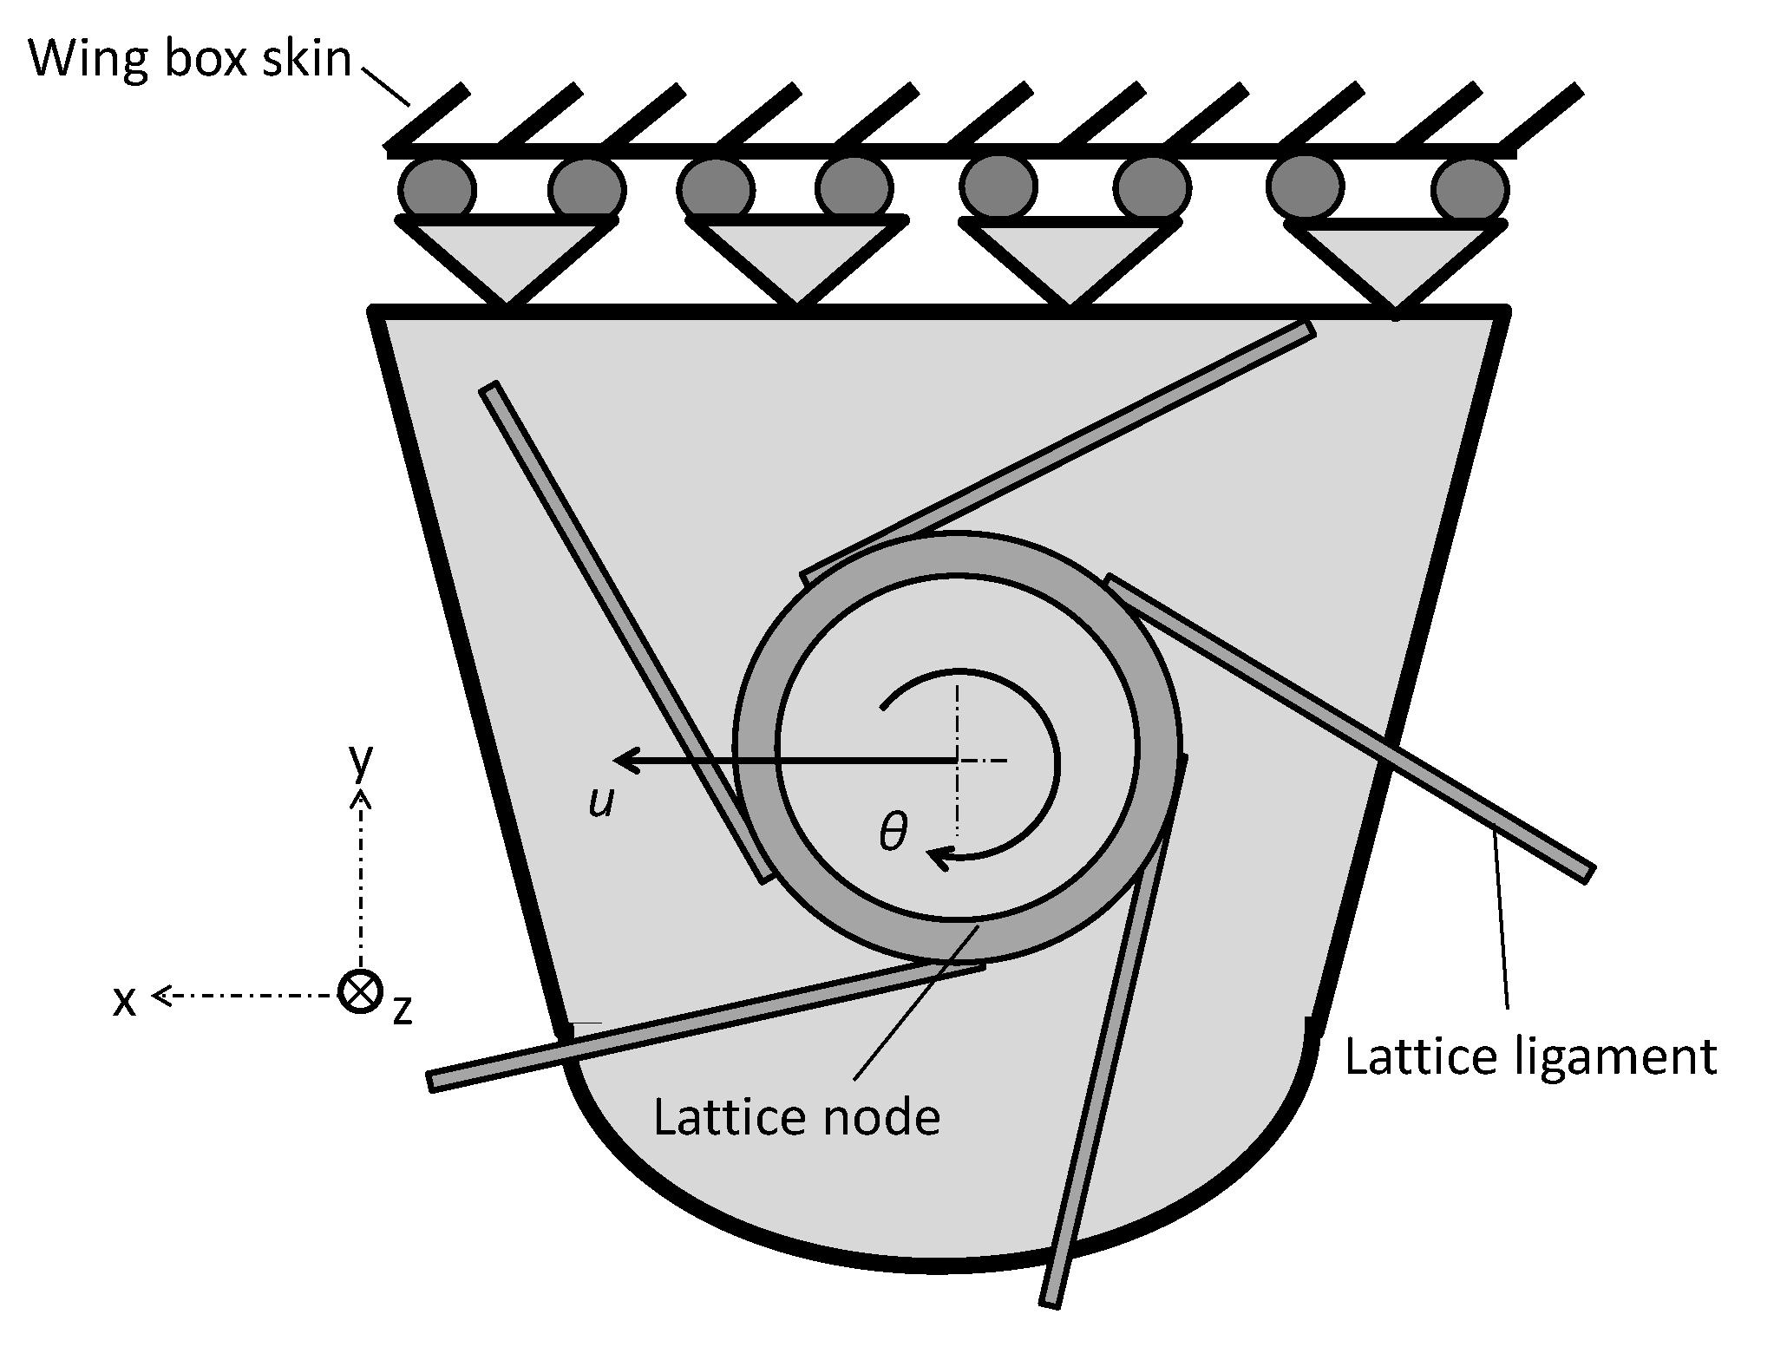
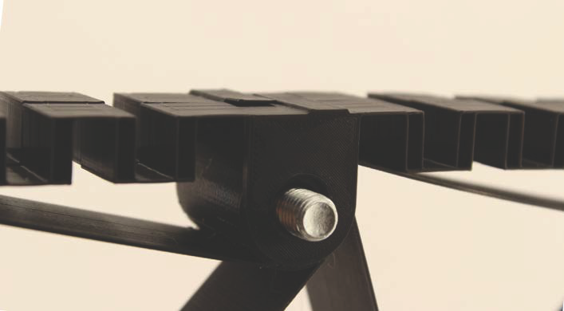
Computational model
Alejandro Valverde
alejandro.valverde@cranfield.ac.uk
Connection between the chiral lattice and wing-box skin
Loads are transmitted to the lattice through this attachment points that is why its design results crucial
Degrees of freedom unrestricted: u and θ
Fig 25: Connection between the chiral lattice and the skin on the manufactured demonstrator, Vincenz (2016)
Fig 24: Sketch of the connection between the chiral node
Notes:
Another aspect of the design is the connection between the chiral structure to the wing-box skin.
Through this connection, loads are transmitted to the lattice structure.
These kind of connection leaves free two degrees of freedom:
The rotation of the chiral nodes around its axis, and, optionally…
The translation of the chiral nodes parallel to the skin
Now, the results of the simulations carried out with the computational model are presented

Slide 14
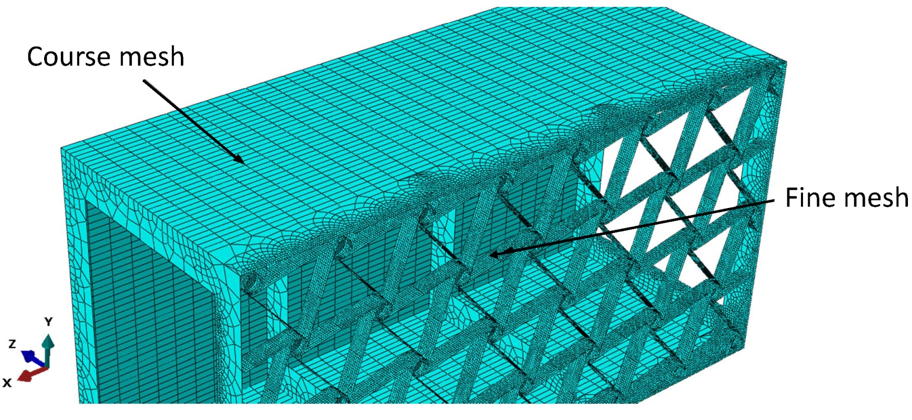
Computational model
Alejandro Valverde
alejandro.valverde@cranfield.ac.uk
Computational mesh description
Fine mesh size, typically equal to 3 mm.
Course mesh size, typically equal to 30 mm
Fig 26: Different mesh regions

Slide 15
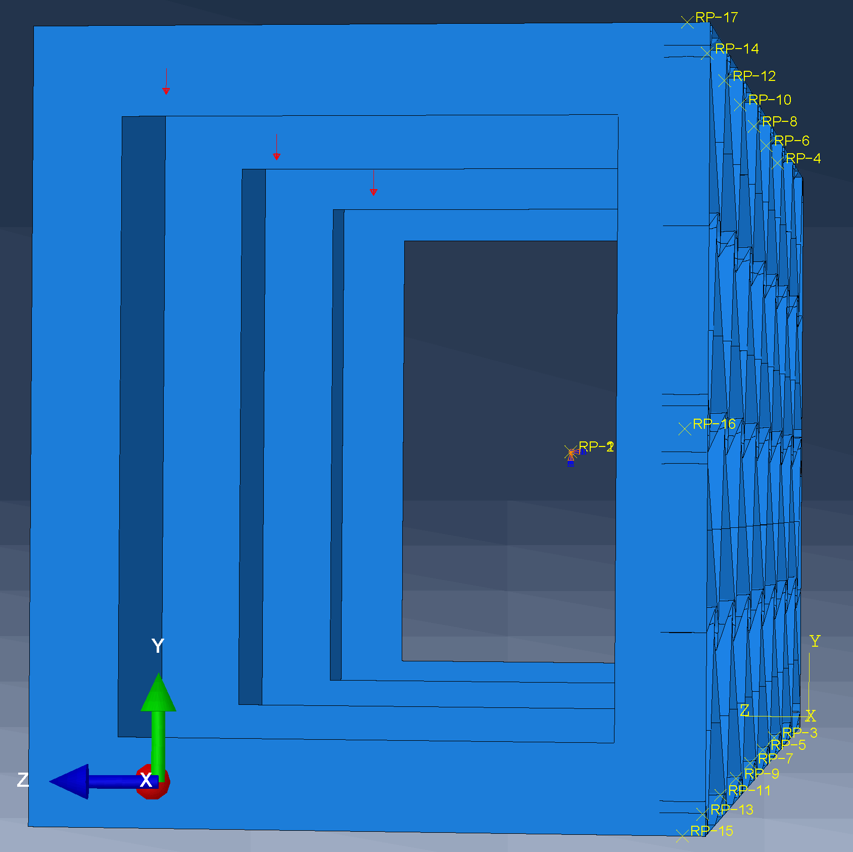
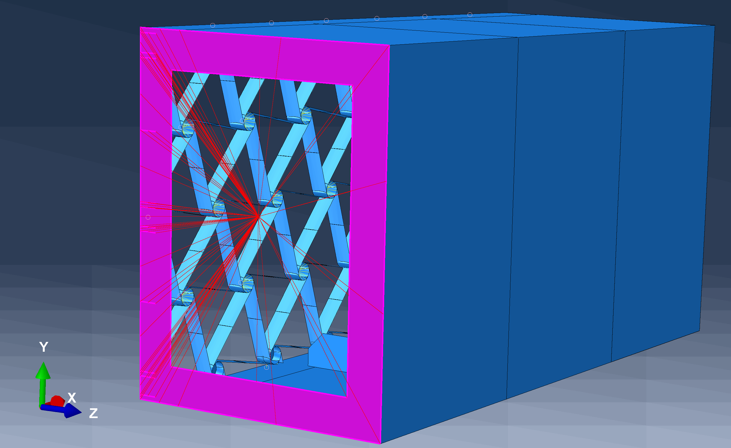
Computational model
Alejandro Valverde
alejandro.valverde@cranfield.ac.uk
Load introduction and boundary condition
Fig 27: Fixed boundary condition
Fig 28: Load introduction points
Notes:
The computational model is characterized for the following parts…
The model is built using python scripting and a program is written that automatically executes a number of simulations for a range of parameters

Slide 16
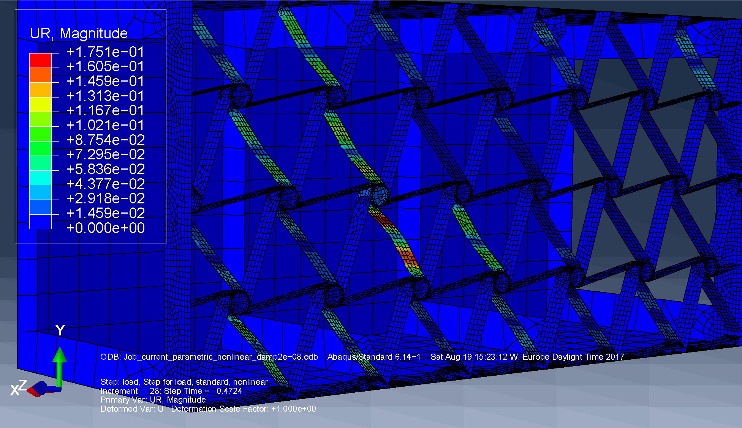
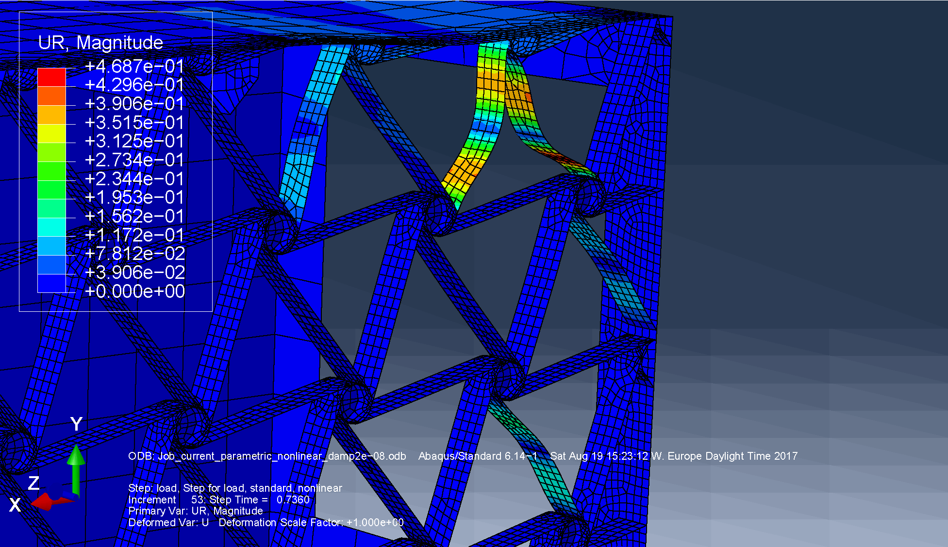
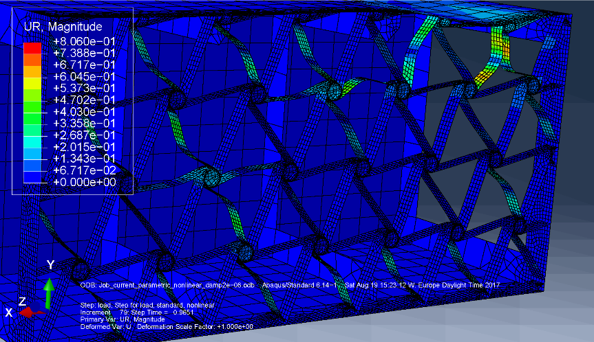
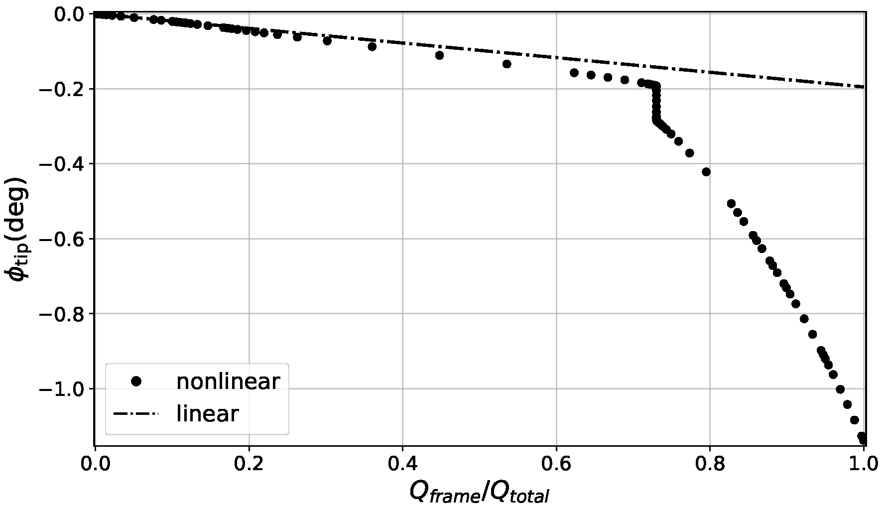
Computational model
Alejandro Valverde
alejandro.valverde@cranfield.ac.uk
Response characterization for the baseline configuration (prescribed load is 2000N)
Fig 29: Elastic instabilities for 47% of the prescribed force applied
Fig 30: Elastic instabilities for 73% of the prescribed force applied
Fig 31: Elastic instabilities for 96% of the prescribed force applied
Fig 32: Displacement-force curve
Notes:
The general response is characterized as shown in this slide.
For initial increments of load, buckling appears at the tip of the wing-box
Then, at certain moment, the buckling limit is achieved for some of the ligaments located at the root. This occurrence of elastic instabilities in this ligaments causes the sudden twist adaptation of the wing-box.
Finally, for higher loads, the instabilities appear in other parts of the structure and the twist adaptation keeps increasing.

Slide 17
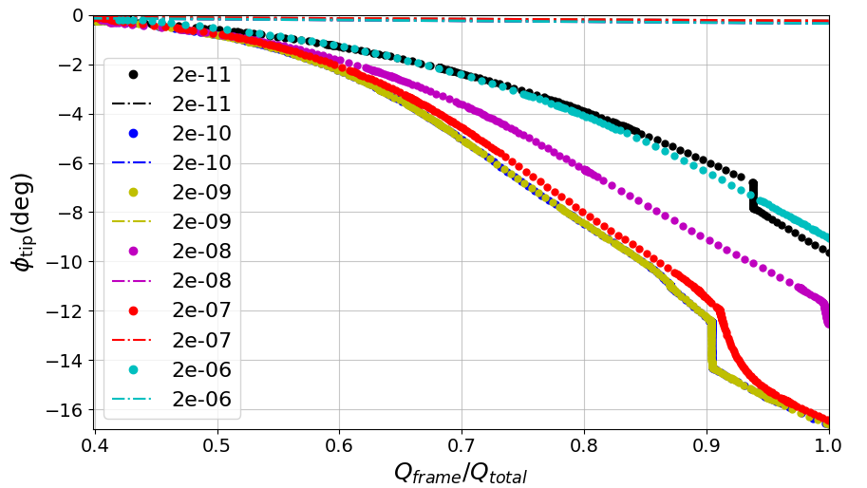
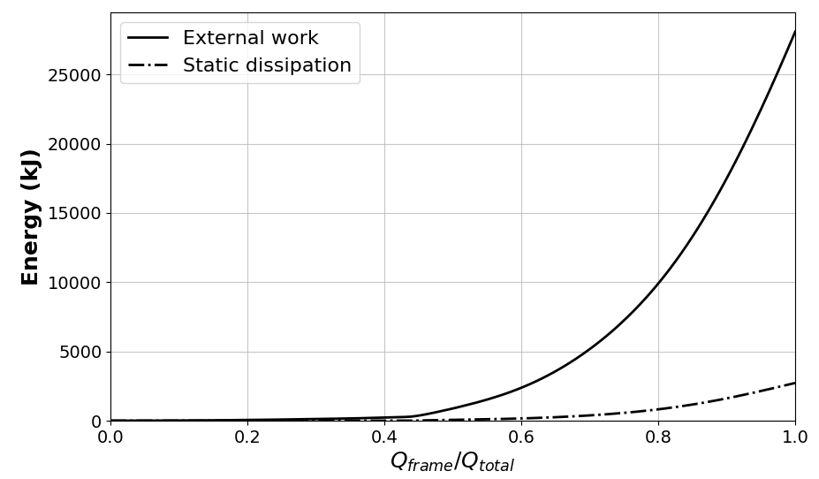
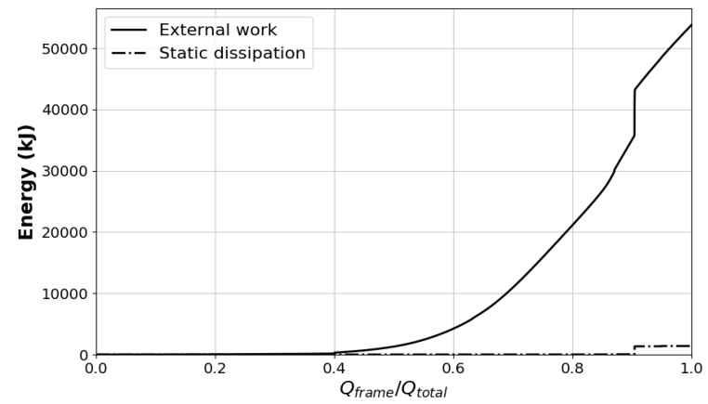
Computational model analysis
Alejandro Valverde
alejandro.valverde@cranfield.ac.uk
Artificial static energy dissipation using constant damping factor (c)
Fig 34: External work vs static energy dissipated through artificial damping, for c = 10⁻⁶
Fig 35: External work vs static energy dissipated through artificial damping, for c = 10⁻⁹
Fig 33: Displacement-force curve for various values of constant damping factor c. Prescribed load is 2000N.
Notes:
The particular characteristics of the problem studied make it likely to become unstable. To account this phenomena, it is necessary to add artificial structural damping. This is done by the incorporation of constant damping factor.
However, special care needs to be taken in order to ensure that the inclusion of artificial damping factor is not leading to inaccurate results due to over-damping of the structure. To ensure that this is not happening, it is possible to compare the external work to the energy dissipated through artificial damping and ensure that is neglectable in comparison.

Slide 18
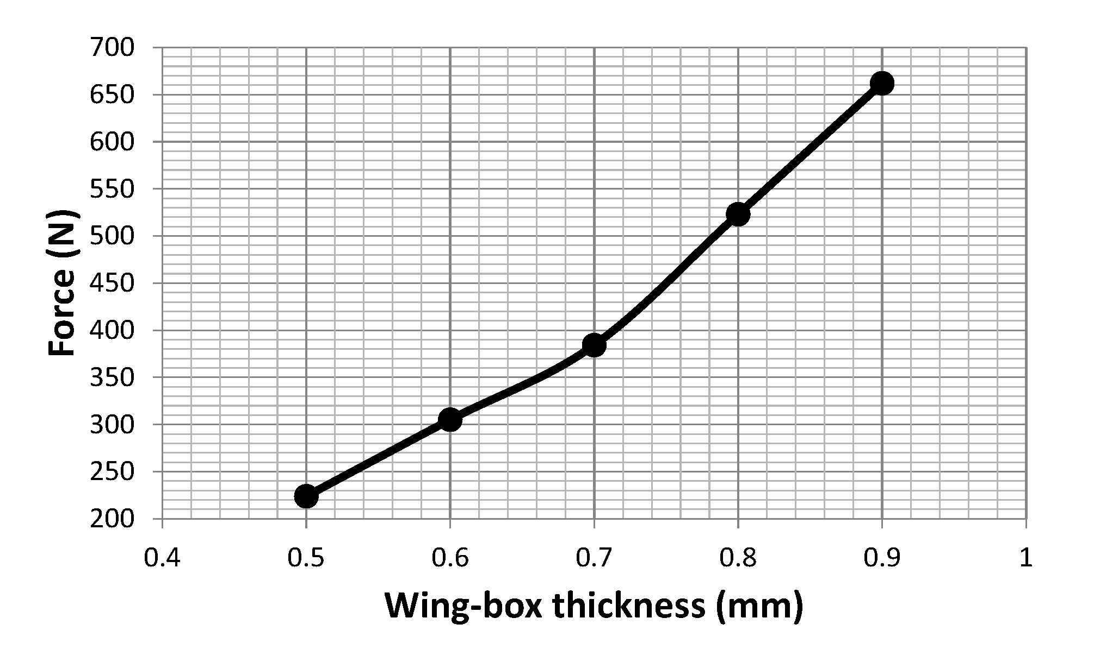
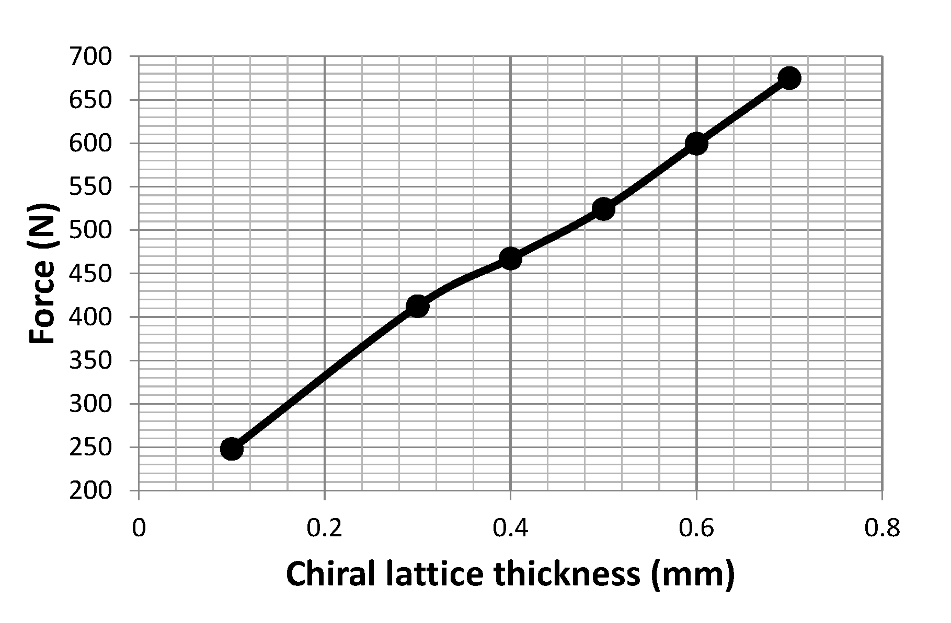
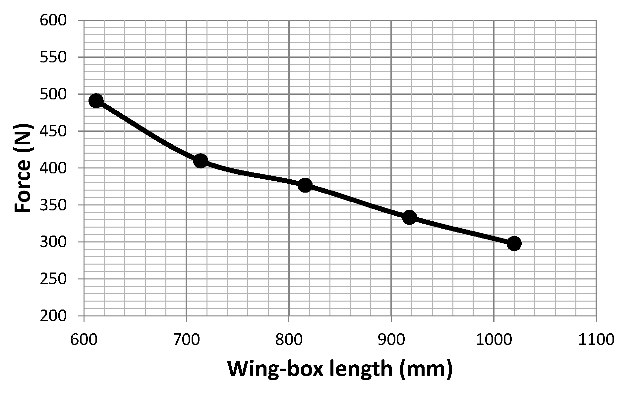
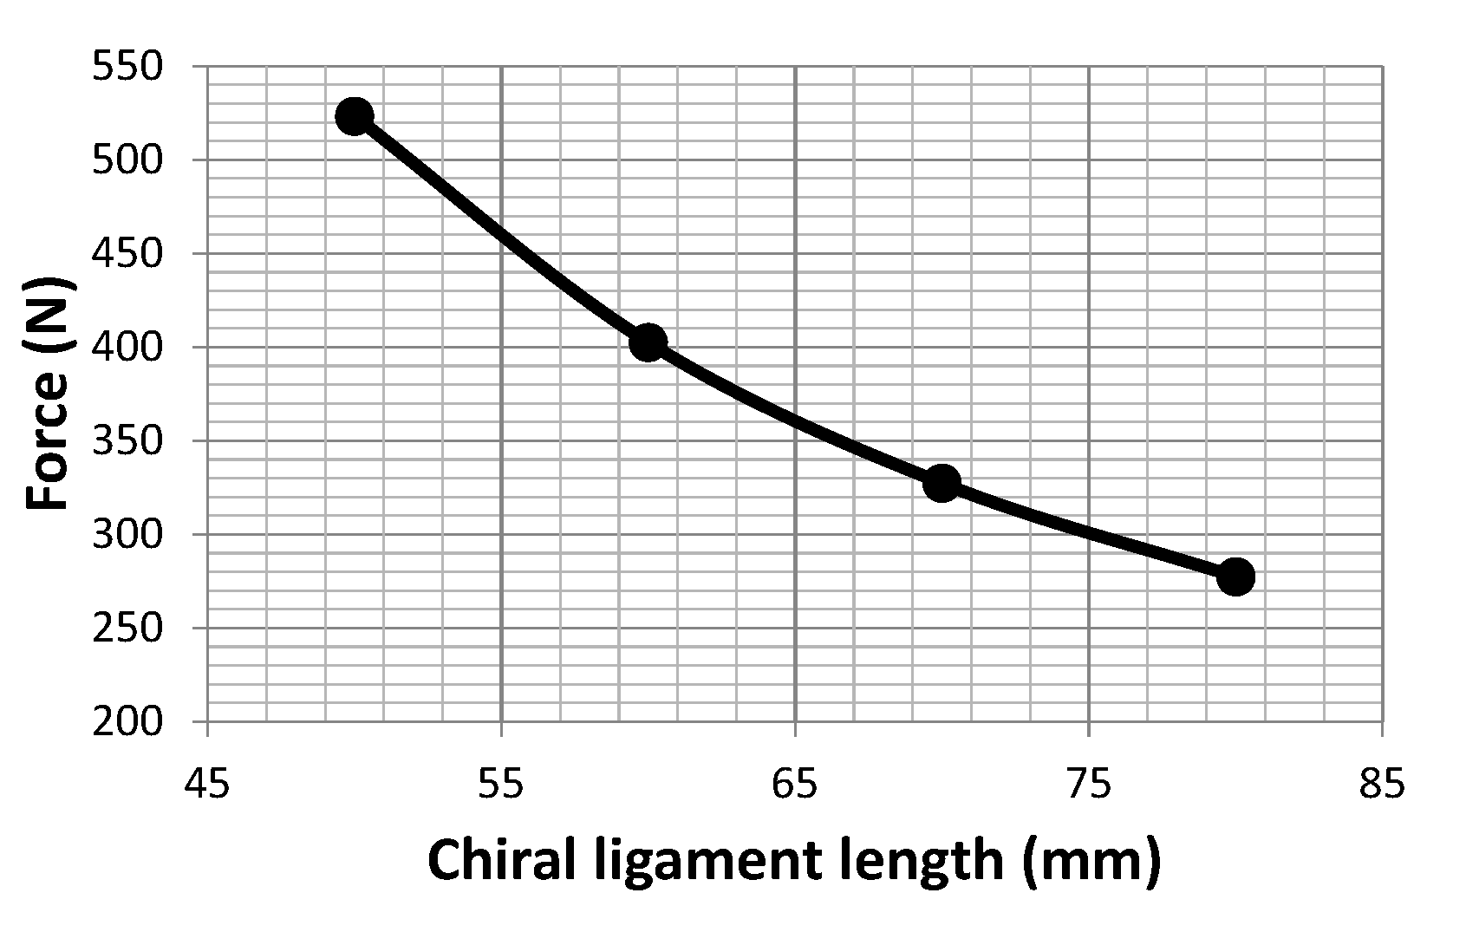
Computational model analysis
Alejandro Valverde
alejandro.valverde@cranfield.ac.uk
Buckling phenomena offset as function of design parameters
Fig 36: Force that induces the structure to collapse as a function of the wing-box wall thickness
Fig 37: Force that induces the structure to collapse as a function of the chiral lattice thickness
Fig 38: Force that induces the structure to collapse as a function of the chiral ligament length
Fig 39: Force that induces the structure to collapse as a function of the wing-box length
Notes:
Positive slope:
Wing-box thickness
Chiral lattice thickness
Negative slope
Wing-box length
Chiral ligament length

Slide 19
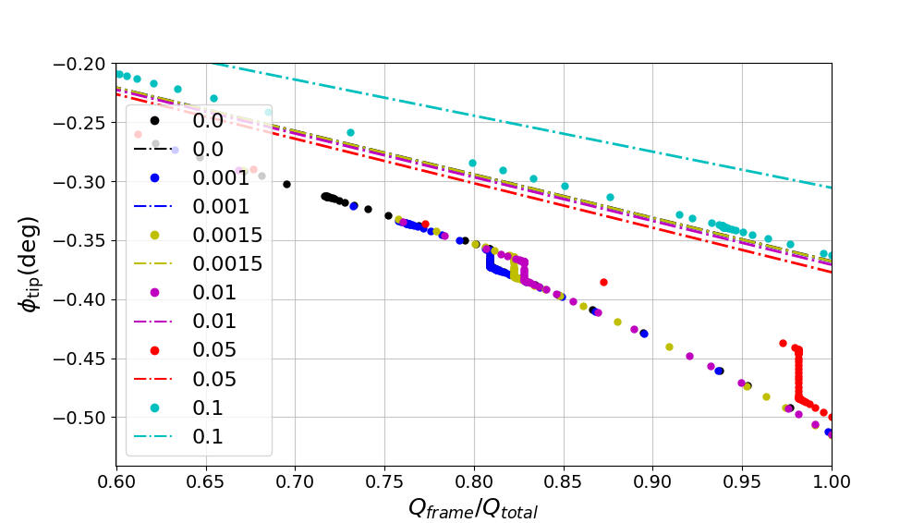
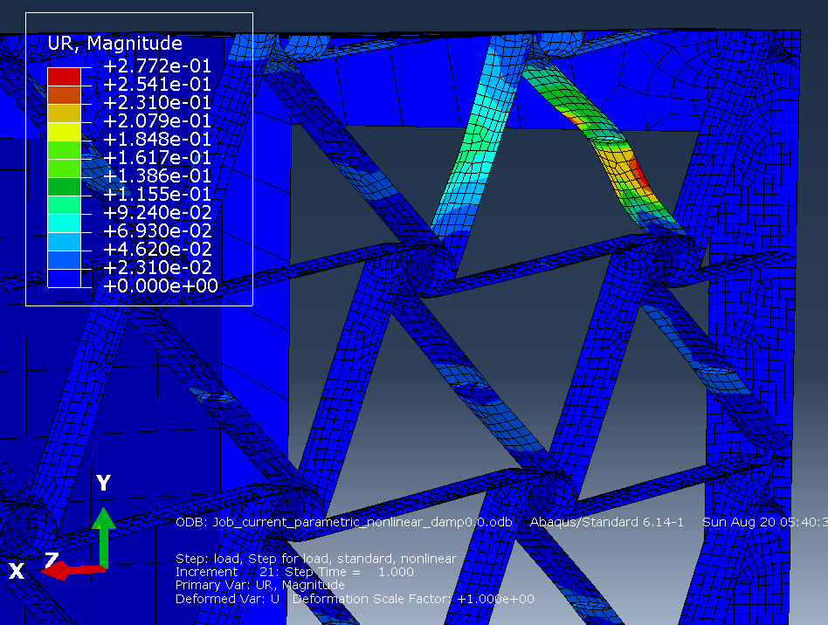
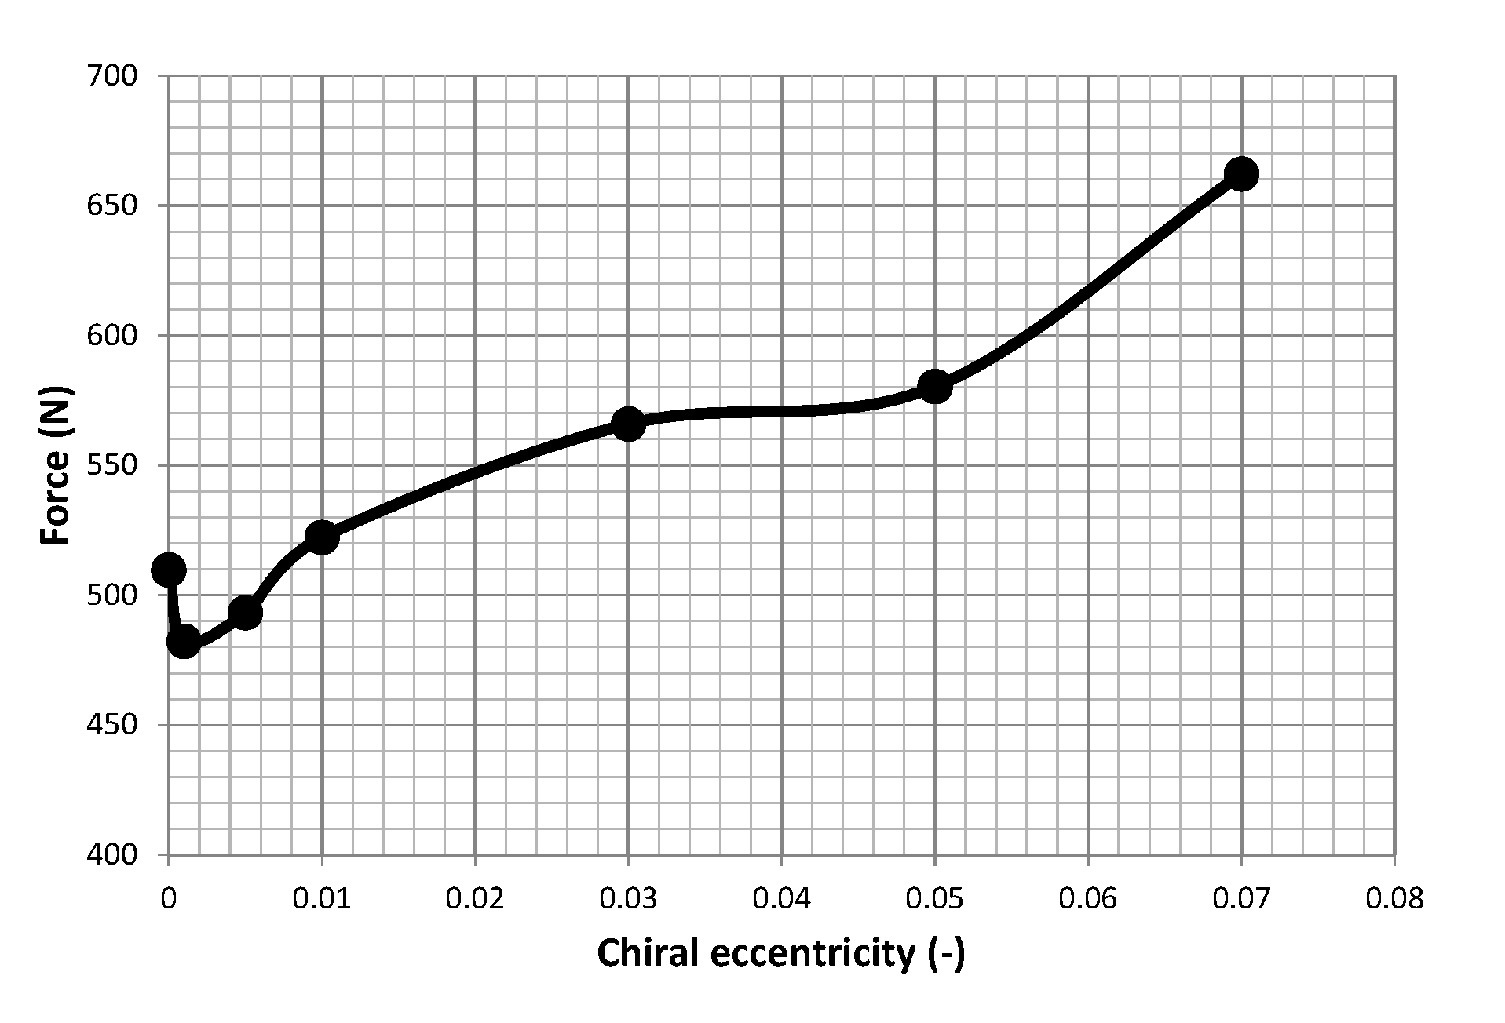
Computational model analysis
Alejandro Valverde
alejandro.valverde@cranfield.ac.uk
Chiral eccentricity
Fig 40: Displacement-force curve for various values of chiral ligament eccentricity. Prescribed load is 2000N
Fig 42: Force that induces the structure to collapse as a function of the chiral lattice thickness
Fig 41: Elastic instabilities for e/B = 0.1
Notes:
Chiral ligament eccentricity

Slide 20
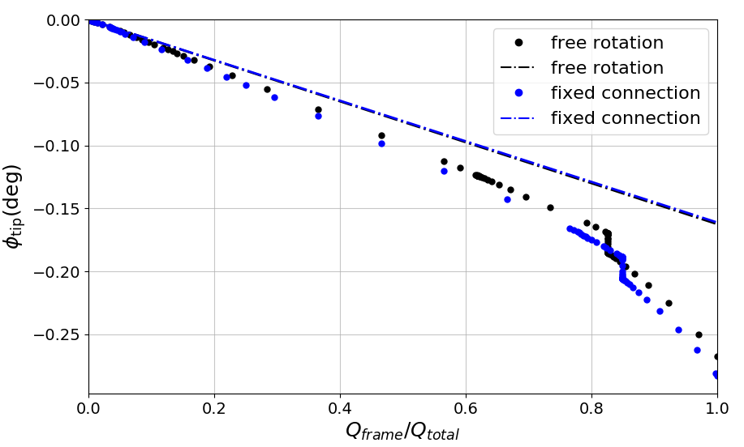
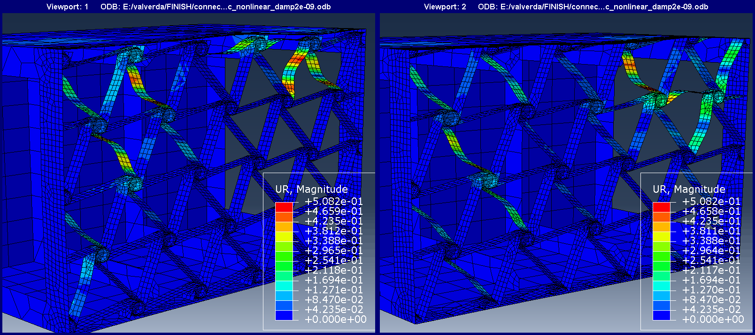
Computational model further analysis
Alejandro Valverde
alejandro.valverde@cranfield.ac.uk
Connection between the chiral lattice and the wing-box skin
Fig 43: Elastic instabilities appearance at the chiral ligaments at the root for free rotation (left) and fixed (right) connections between the chiral structure and the wing-box skin
Fig 44: Force that induces the structure to collapse for different type of connections between the chiral structure and the wing-box skin. Prescribed load is 2000N.
Notes:
Free rotation of the nodes at the boundary between the lattice structure and the wing-box skin

Slide 21
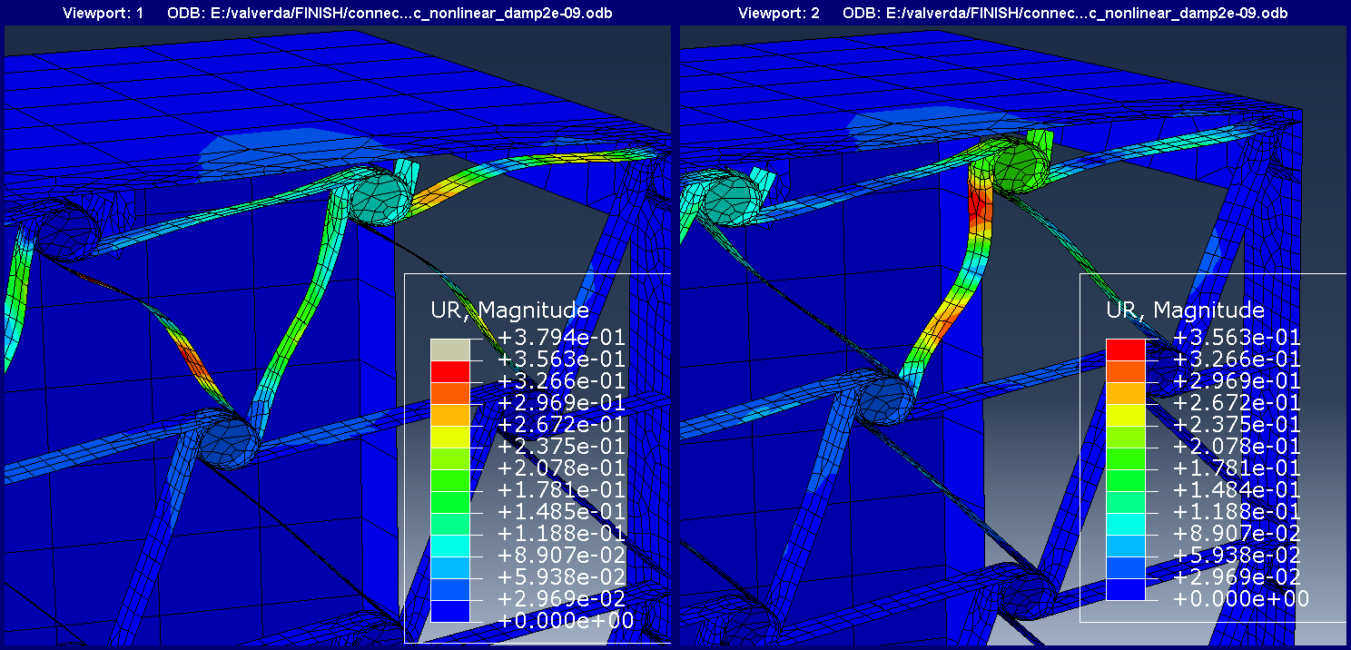

Computational model further analysis
Alejandro Valverde
alejandro.valverde@cranfield.ac.uk
Additional degree of freedom for the connection
Fig 45: Elastic instabilities appearance at the chiral ligaments at the root for fixed (left) and free (right) displacement of the lattice node
Fig 46: Force that induces the structure to collapse as a function of the wing-box wall thickness. Prescribed load is 2000N.

Slide 22


Computational model further analysis
Alejandro Valverde
alejandro.valverde@cranfield.ac.uk
Control over the magnitude of the sudden twist adaptation through the chiral structure thickness
Fig 47: Elastic instabilities appearance at the chiral ligaments at the root for t_{chiral} = 0.2 (left) when 59% of the prescribed load has been applied and for t_{chiral} = 0.5 (right) when 93% of the prescribed load has been applied.
Fig 48: Force that induces the structure to collapse as a function of the chiral structure thickness. Prescribed load is 2000N.

Slide 23
Conclusions
Alejandro Valverde
alejandro.valverde@cranfield.ac.uk
The technology proposed has been shown capable of inducing global twist morphing exploiting local elastic instabilities.
Achieved wing-box twist adaptation is in the order of degrees.
Additional tailorability of the buckling phenomena offset and evolution is provided by modification of a number of design parameters.
Control over the load required to onset the mechanism is provided by:
Wing-box thickness
Chiral ligament length
Wing-box length
Chiral ligament eccentricity
The magnitude of the sudden twist adaptation can be control control by the chiral thickness.

Slide 24
Outlook
Alejandro Valverde
alejandro.valverde@cranfield.ac.uk
Implementation of the wing-box model into a more complex wing model with aerodynamic loads.
Manufacture of a demonstrator to experimentally validate the proposed technology.
Evaluation of the time-bounded response would be essential prior implementation of the system on a real lift generating structure.

Slide 25
References
Alejandro Valverde
alejandro.valverde@cranfield.ac.uk
W. Raither, A. Bergamini, F. Gandhi, and P. Ermanni, “Adaptive bending-twist coupling in laminated composite plates by controllable shear stress transfer,” in Composites Part A: Applied Science and Manufacturing, vol. 43, pp. 1709–1716, 2012.
W. Raither, A. Bergamini, and P. Ermanni, “Profile beams with adaptive bending-twist coupling by adjustable shear centre location,” Journal of Intelligent Material Systems and Structures, vol. 24, no. 3, pp. 334–346, 2013.
G. Ramstein, Experimental Validation of Chiral Structures with Local Controlled Instabilities. Semester project no. 16-015, ETH Zürich, 2016.
R. Vincenz, Airfoil camber morphing exploiting chiral structures: Manufacturing and testing. Semester project no. 17-041, ETH Zürich, 2017.

